Slide 1
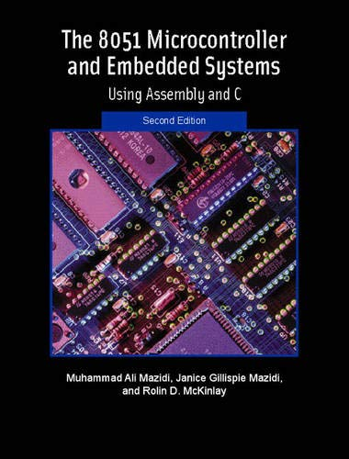
THE 8051
MICROCONTROLLER & Embedded Systems
Muhammad Ali Mazidi, Janice Mazidi
& Rolin McKinlay

Slide 2
8051 ASSEMBLY LANGUAGE
PROGRAMMING
Chapter 2

Slide 3
Objectives
Upon completion of this chapter, you will be able to:
>> List the registers of the 8051 microcontroller
>> Manipulate data using the registers and MOV instructions
>> Code simple 8051 Assembly language instructions
>> Assemble and run an 8051 program
>> Describe the sequence of events that occur upon 8051 power-up
>> Examine programs in ROM code of the 8051
>> Explain the ROM memory map of the 8051
>> Detail the execution of 8051 Assembly language instructions
>> Describe 8051 data types
>> Explain the purpose of the PSW (program status word) register
>> Discuss RAM memory space allocation in the 8051
>> Diagram the use of the stack in the 8051
>> Manipulate the register banks of the 8051
>> Understand the RISC and CISC architectures

Slide 4
Objectives
Section 2.1, Looking at the inside of the 8051 and demonstrating some of the widely used registers of the 8051 such as MOV and ADD,
Section 2.2, examining Assembly language and machine language programming and defining terms such as mnemonics, opcode, operand, etc.,
Section 2.3, step-by-step execution of an 8051 program,
Section 2.4, examining the role of the program counter,
Section 2.5, looking at some widely used Assembly language directives, pseudocode, and data types related to the 8051
Section 2.6, discussing the flag bits and how they are affected by arithmetic instructions
Section 2.7, allocation of RAM memory inside the 8051 plus the stack and register banks of the 8051
Section 2.8, the concepts of RISC and CISC architectures

Slide 5
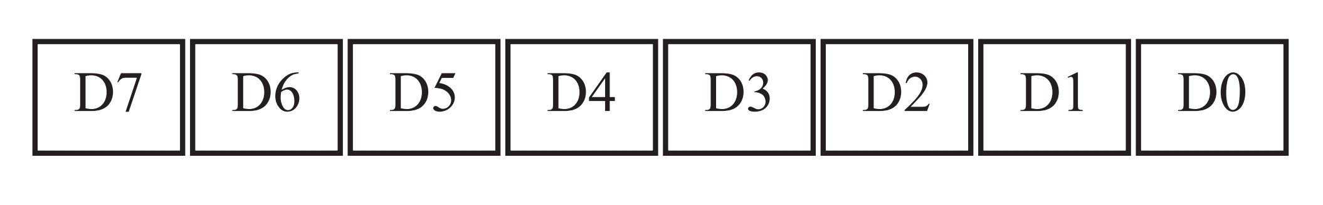
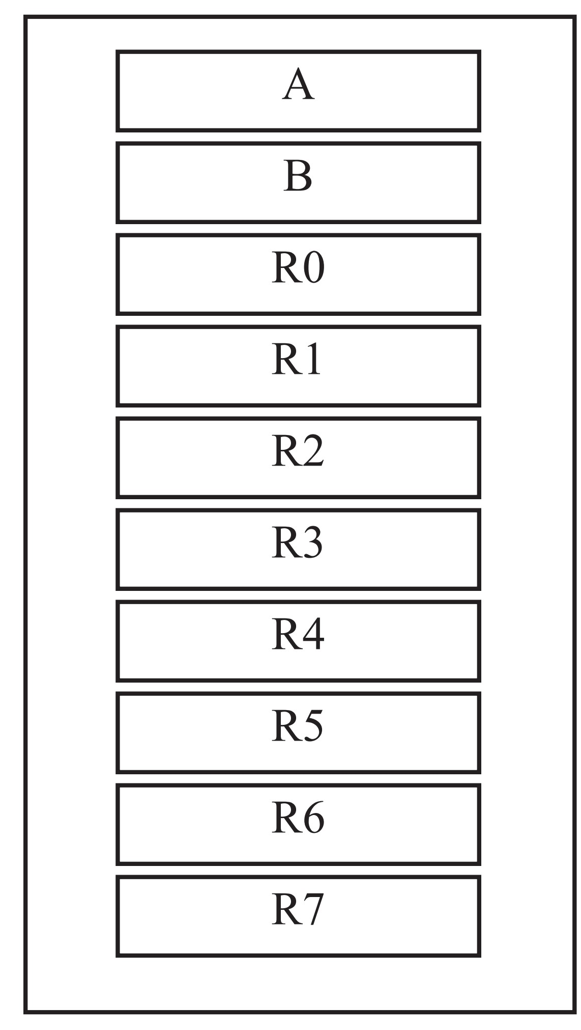
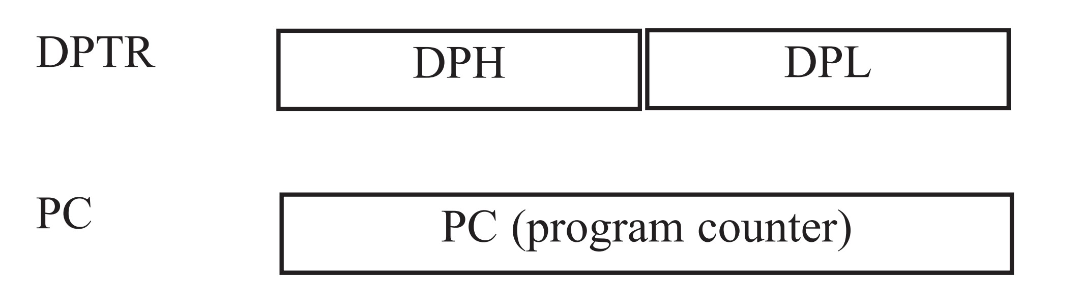
Inside the 8051
The vast majority of 8051 registers are 8-bit registers.
Figure 2-1 (a). Some 8-bit Registers
of the 8051
Figure 2-1 (b). Some 8051 16-bit Registers

Slide 6
MOV Instruction
Simply stated,
the MOV instruction copies data from one location to another.
MOV Instruction Format:
MOV destination, source ;copy source to dest
This instruction tells the CPU
to move (in reality, copy) the source operand to the destination operand.

Slide 7
ADD Instruction
ADD Instruction Format:
ADD A,source ;ADD the source operand
;to the accumulator
The ADD instruction tells the CPU
to add the source byte to register A
and put the result in register A.

Slide 8
Structure of Assembly Language
An Assembly language instruction consists of four fields:
[label:] mnemonic [operands] [;comment]
Brackets indicate that a field is optional, and not all lines have them. Brackets should not be typed in.

Slide 9
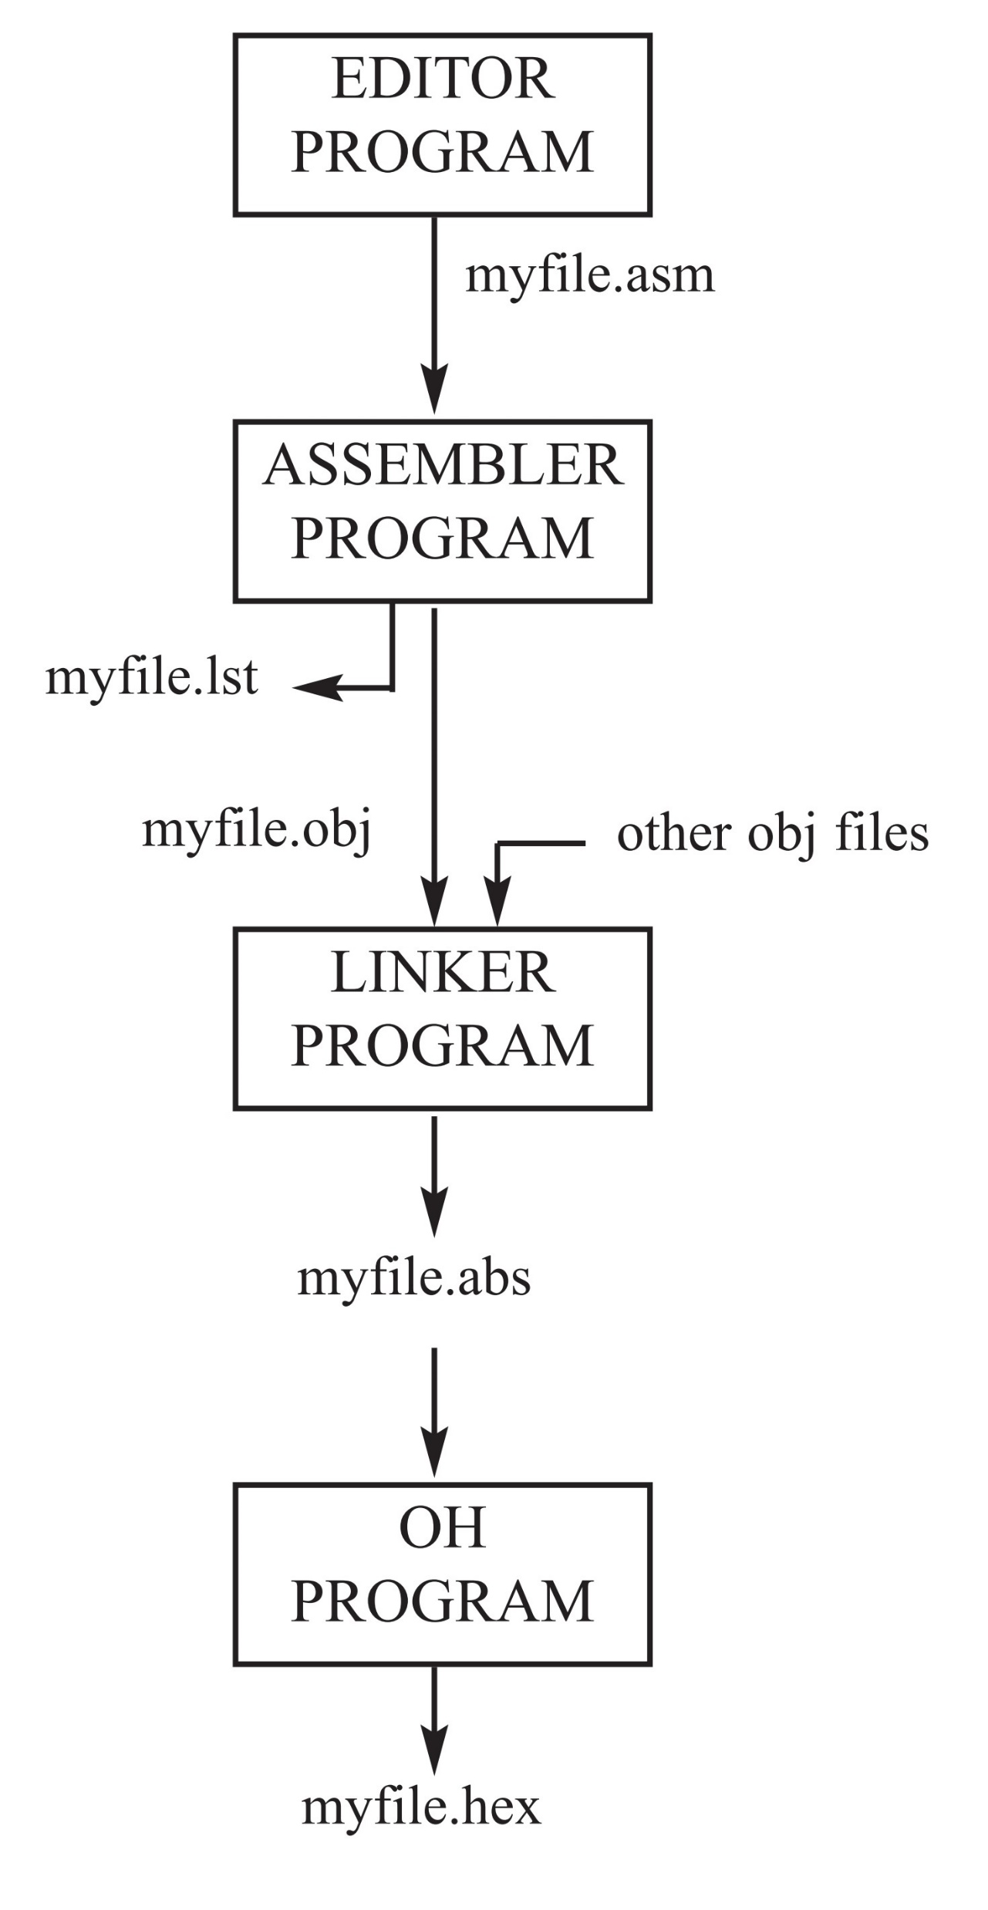
Assembling and Running an 8051 Program
Figure 2-2. Steps to Create a Program
The “asm” file is also called the source file and for this reason some assemblers require that this file have the “src” extension.

Slide 10
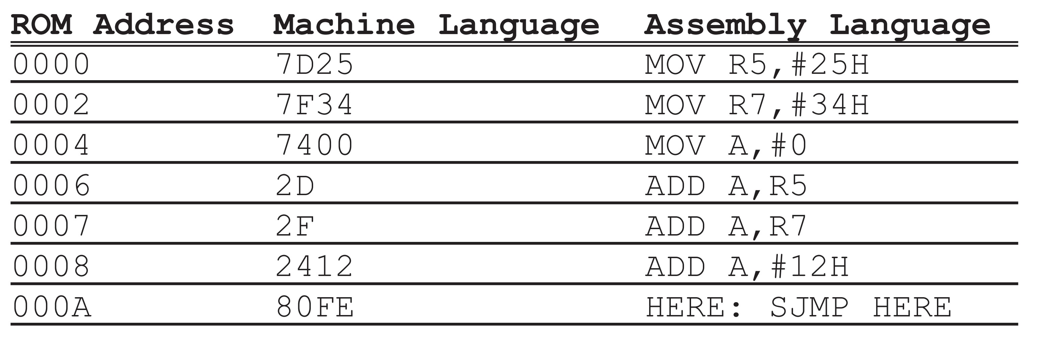
Placing Code in Program ROM

Slide 11
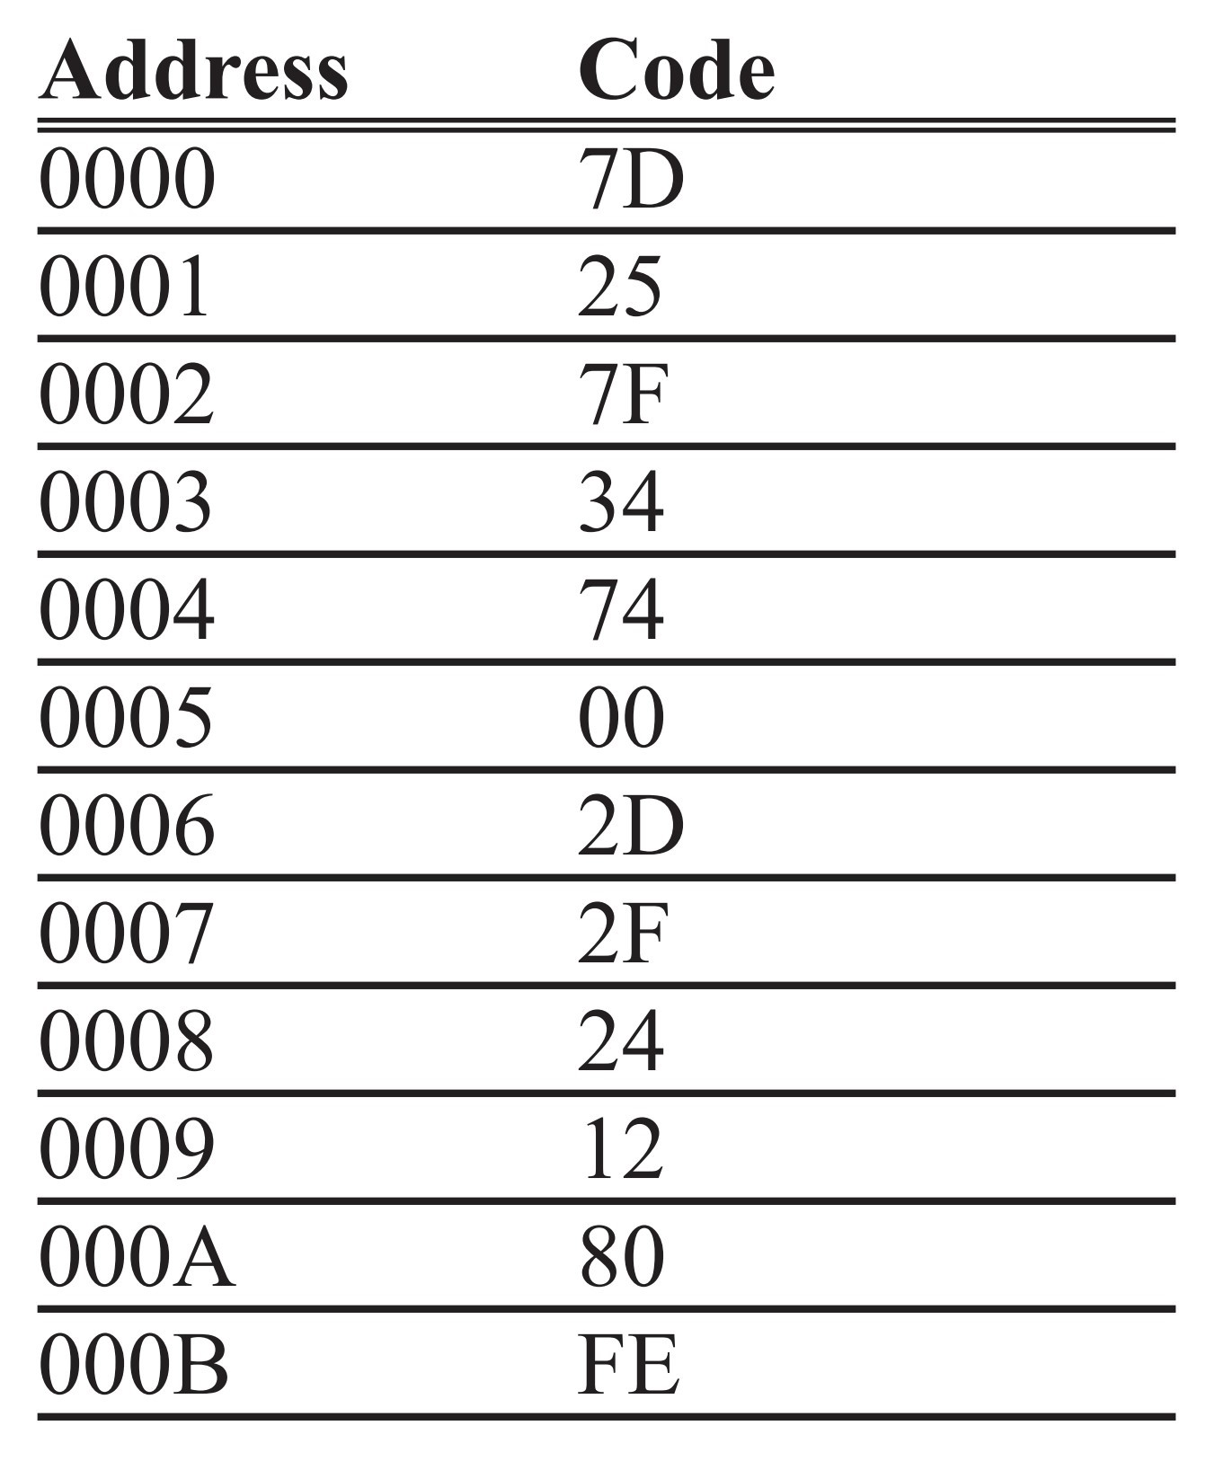
Placing Code in Program ROM
Program 2-1: ROM Contents

Slide 12
Example 2-1
Find the ROM memory address of each of the following 8051 chips.
(a)AT89C51 with 4KB (b) DS89C420 with 16KB (c) DS5000-32 with 32KB
Solution:
With 4K bytes of on-chip ROM memory space, we have 4096 bytes (4x1024 = 4096). This maps to address locations of 0000 to 0FFFH. Notice that 0 is always the first location.
(b) With 16K bytes of on-chip ROM memory space, we have 16,384 bytes (16 x 1024 = 16,384), which gives 0000 - 3FFFH.
(c) With 32K bytes we have 32,768 bytes (32 x 1024 = 32,768). Converting 32,768 to hex, we get 8000H; therefore, the memory space is 0000 to 7FFFH.

Slide 13
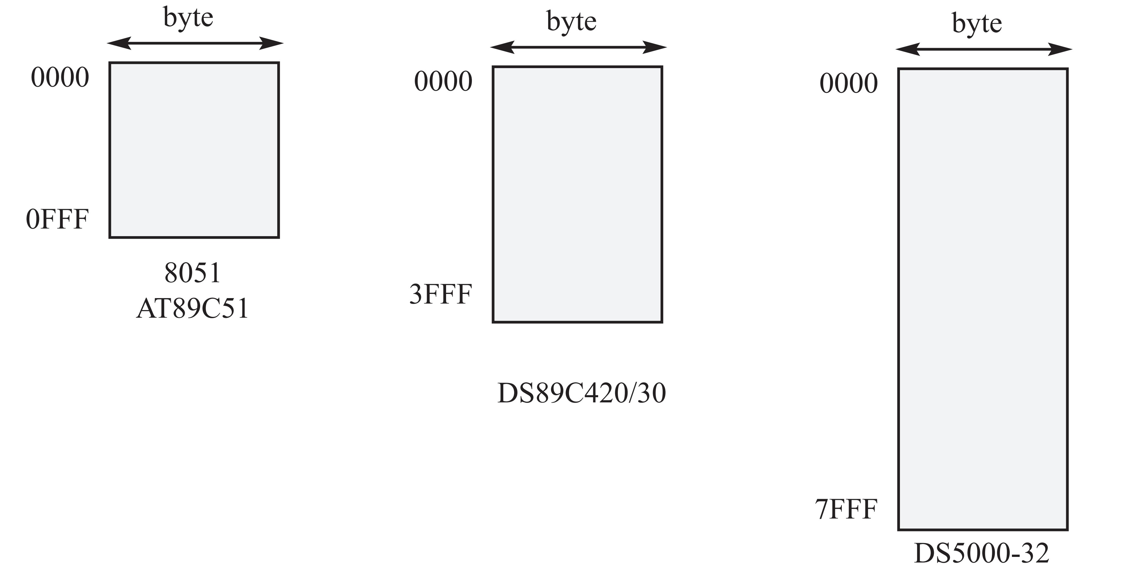
ROM Memory Map in the 8051 Family
Figure 2-3. 8051 On-Chip ROM Address Range

Slide 14
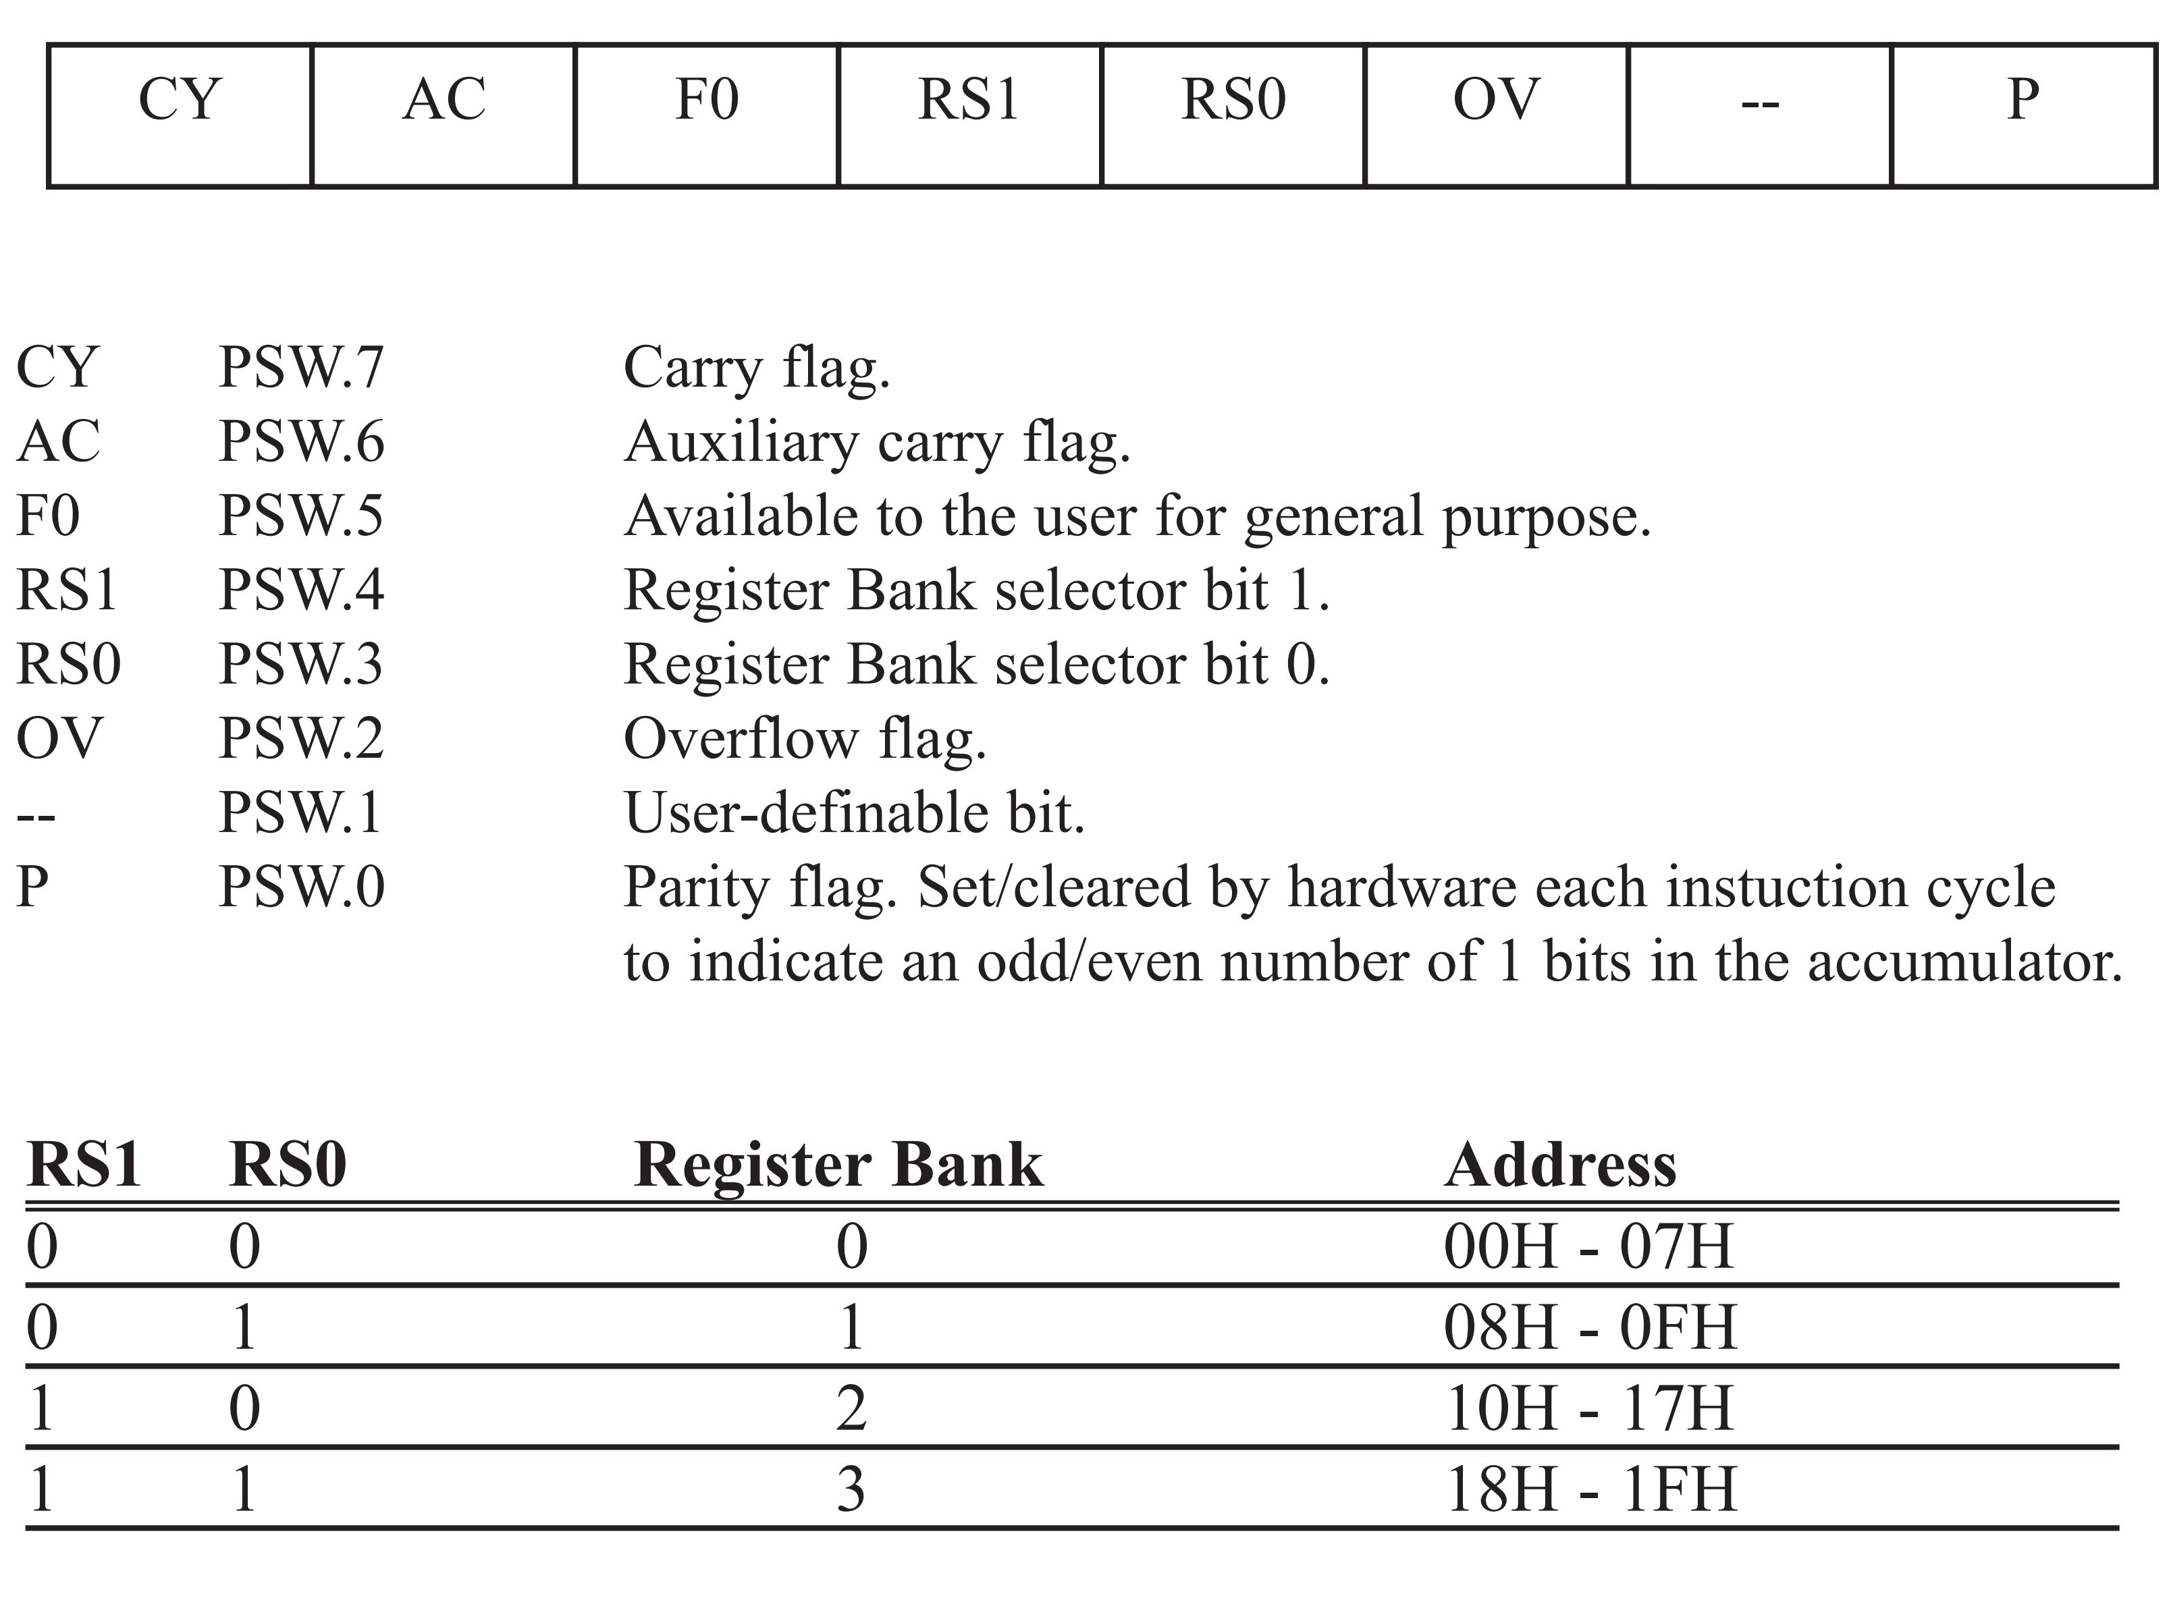
The program status word (PSW) register, also referred to as the flag register, is an 8-bit register.
PSW (Program Status Word) Register
Figure 2-4. Bits of the PSW Register

Slide 15
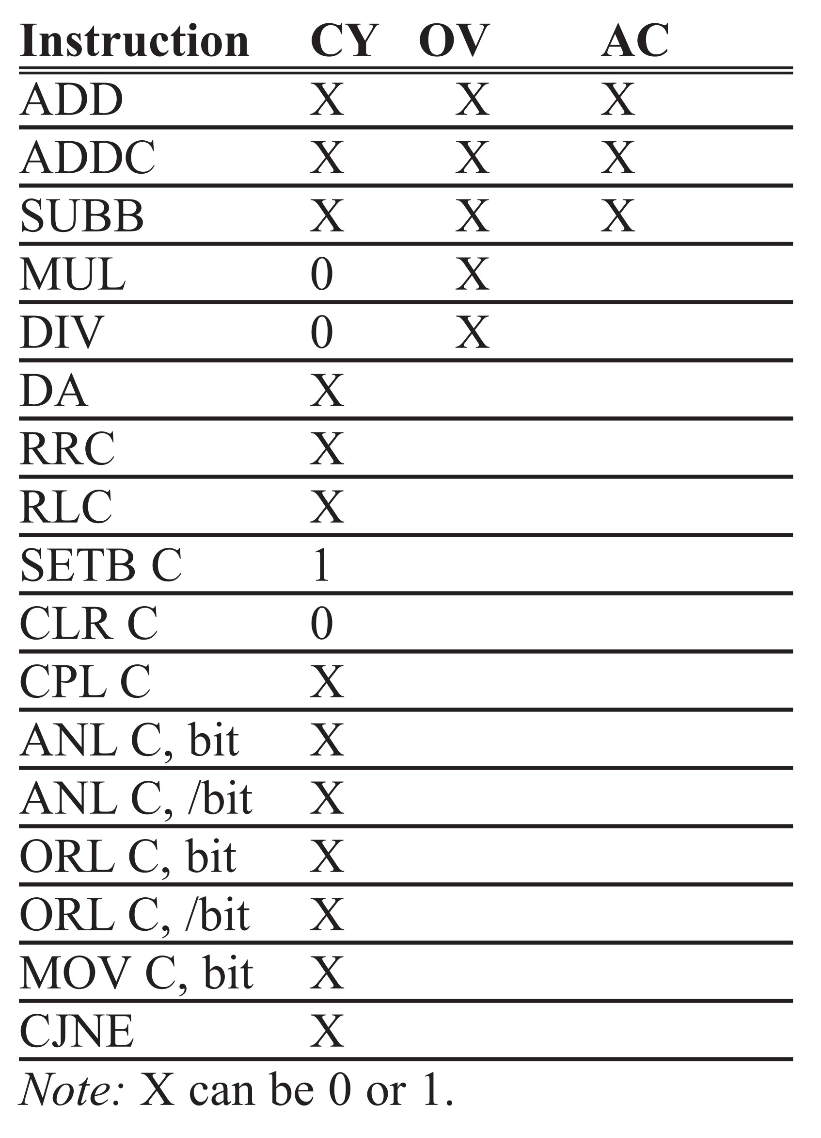
Table 2-1: Instructions That Affect Flag Bits
Note: X can be 0 or 1.

Slide 16
Example 2-2
Show the status of the CY, AC, and P flags after the addition of 38H and 2FH in the following instructions.
MOV A,#38H
ADD A,#2FH ;after the addition A=67H, CY=0
Solution:
38 00111000
+ 2F 00101111
67 01100111
CY = 0 since there is no carry beyond the D7 bit.
AC = 1 since there is a carry from the D3 to the D4 bit.
P = 1 since the accumulator has an odd number of 1s (it has five 1s).

Slide 17
Example 2-3
Show the status of the CY, AC, and P flags after the addition of 9CH and 64H in the following instructions.
MOV A,#9CH
ADD A,#64H ;after addition A=00 and CY=1
Solution:
9C 10011100
+ 64 01100100
100 00000000
CY = 1 since there is a carry beyond the D7 bit.
AC = 1 since there is a carry from the D3 to the D4 bit.
P = 0 since the accumulator has an even number of 1s (it has zero 1s).

Slide 18
Example 2-4
Show the status of the CY, AC, and P flags after the addition of 88H and 93H in the following instructions.
MOV A,#88H
ADD A,#93H ;after the addition A=1BH,CY=1
Solution:
88 10001000
+ 93 10010011
11B 00011011
CY = 1 since there is a carry beyond the D7 bit.
AC = 0 since there is no carry from the D3 to the D4 bit.
P = 0 since the accumulator has an even number of 1s (it has four 1s).

Slide 19
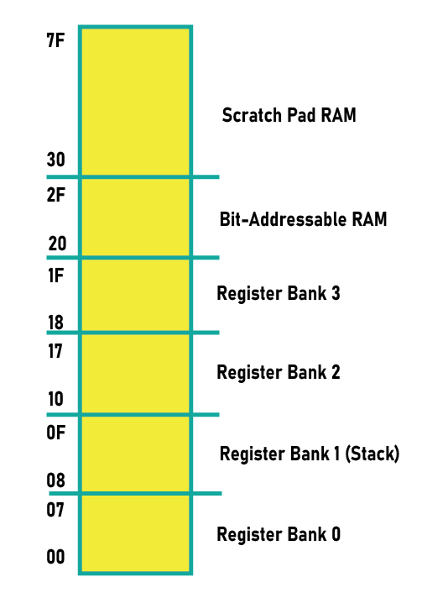
8051 Register Banks and Stack
Figure 2-5. RAM Allocation
in the 8051

Slide 20
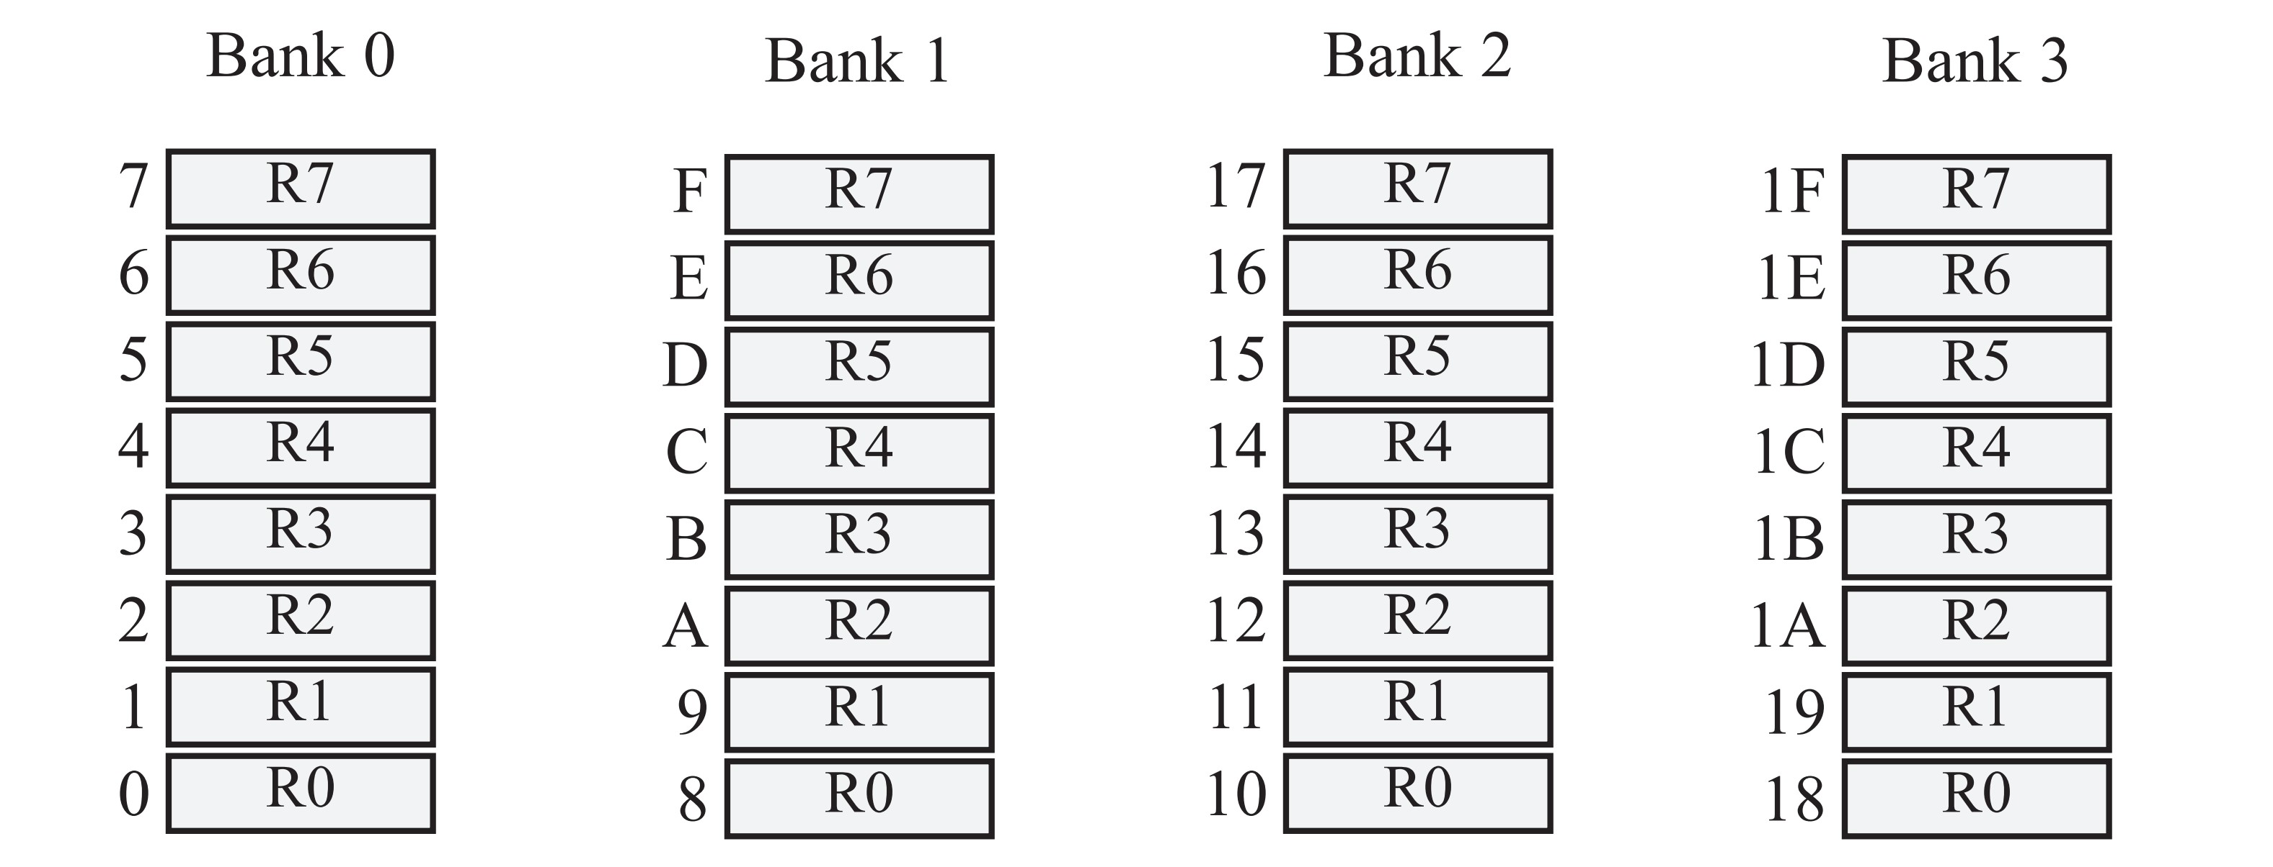
8051 Register Banks and Stack
Figure 2-6. 8051 Register Banks and their RAM Addresses

Slide 21
Example 2-5
State the contents of RAM locations after the following program:
MOV R0,#99H ;load R0 with value 99H
MOV R1,#85H ;load R1 with value 85H
MOV R2,#3FH ;load R2 with value 3FH
MOV R7,#63H ;load R7 with value 63H
MOV R5,#12H ;load R5 with value 12H
Solution:
After the execution of the above program we have the following:
RAM location 0 has value 99H RAM location 1 has value 85H
RAM location 2 has value 3FH RAM location 7 has value 63H
RAM location 5 has value 12H

Slide 22
Example 2-6: Default Register Bank
Repeat Example 2-5 using RAM addresses instead of register names.
Solution:
This is called direct addressing mode and uses the RAM address location for the destination address. See Chapter 5 for a more detailed discussion of addressing modes.
MOV 00,#99H ;load R0 with value 99H
MOV 01,#85H ;load R1 with value 85H
MOV 02,#3FH ;load R2 with value 3FH
MOV 07,#63H ;load R7 with value 63H
MOV 05,#12H ;load R5 with value 12H

Slide 23
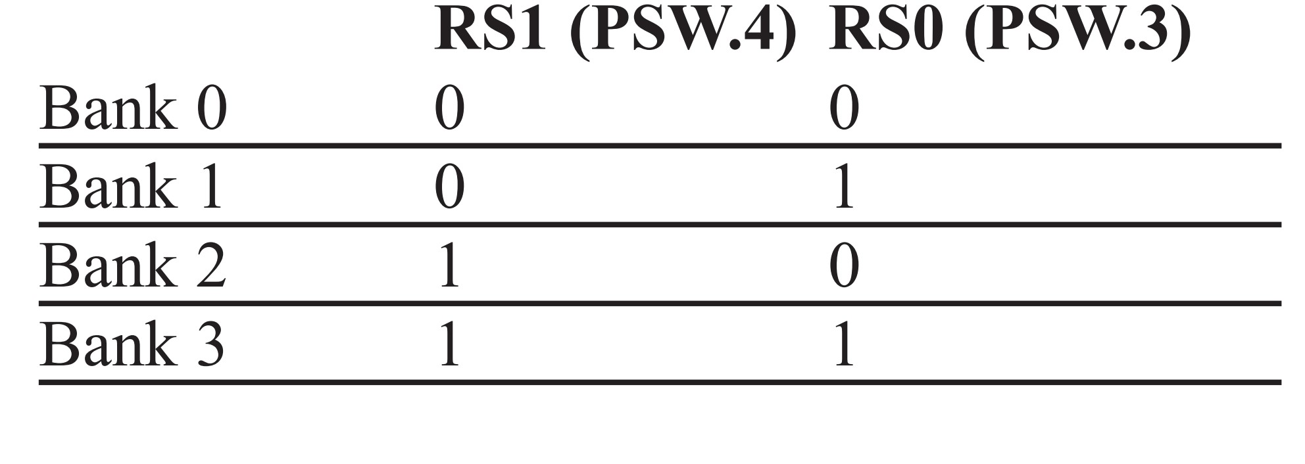
How to Switch Register Banks
Table 2-2: PSW Bits Bank Selection

Slide 24
Example 2-7
State the contents of the RAM locations after the following program:
SETB PSW.4 ;select bank 2
MOV R0,#99H ;load R0 with value 99H
MOV R1,#85H ;load R1 with value 85H
MOV R2,#3FH ;load R2 with value 3FH
MOV R7,#63H ;load R7 with value 63H
MOV R5,#12H ;load R5 with value 12H
Solution:
By default, PSW.3=0 and PSW.4=0; therefore, the instruction “SETB PSW.4” sets RS1=1 and RS0=0, thereby selecting register bank 2. Register bank 2 uses RAM locations 10H - 17H. After the execution of the above program we have the following:
RAM location 10H has value 99H RAM location 11H has value 85H
RAM location 12H has value 3FH RAM location 17H has value 63H
RAM location 15H has value 12H

Slide 25
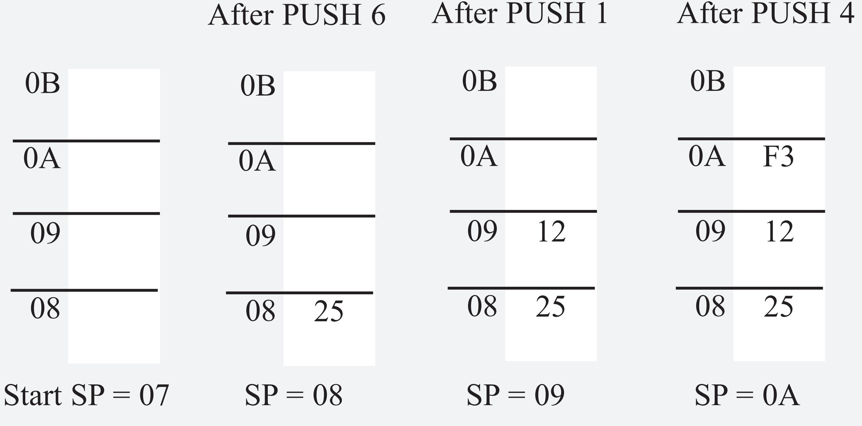
Example 2-8: Pushing onto the Stack
Show the stack and stack pointer for the following. Assume the default stack area and register 0 is selected.
MOV R6,#25H
MOV R1,#12H
MOV R4,#0F3H
PUSH 6
PUSH 1
PUSH 4
Solution:

Slide 26
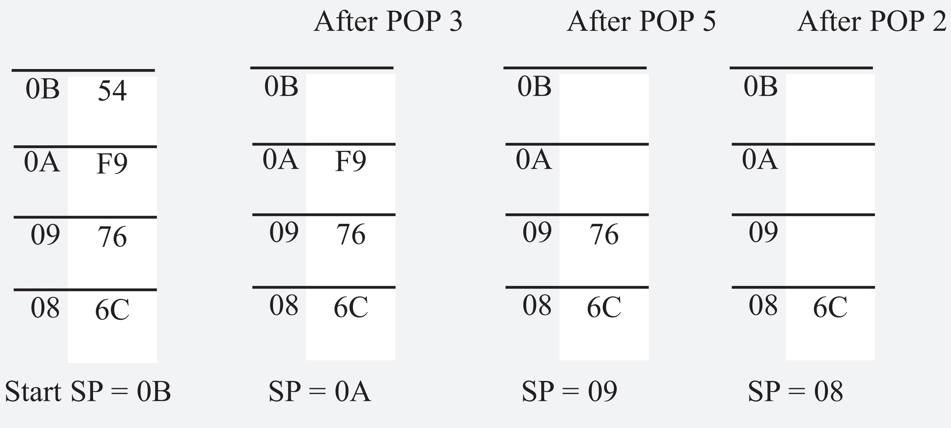
Example 2-9: Popping from the Stack
Examining the stack, show the contents of the registers and SP after execution of the following instructions. All values are in hex.
POP 3 ;POP stack into R3 POP 5 ;POP stack into R5
POP 2 ;POP stack into R2
Solution:

Slide 27
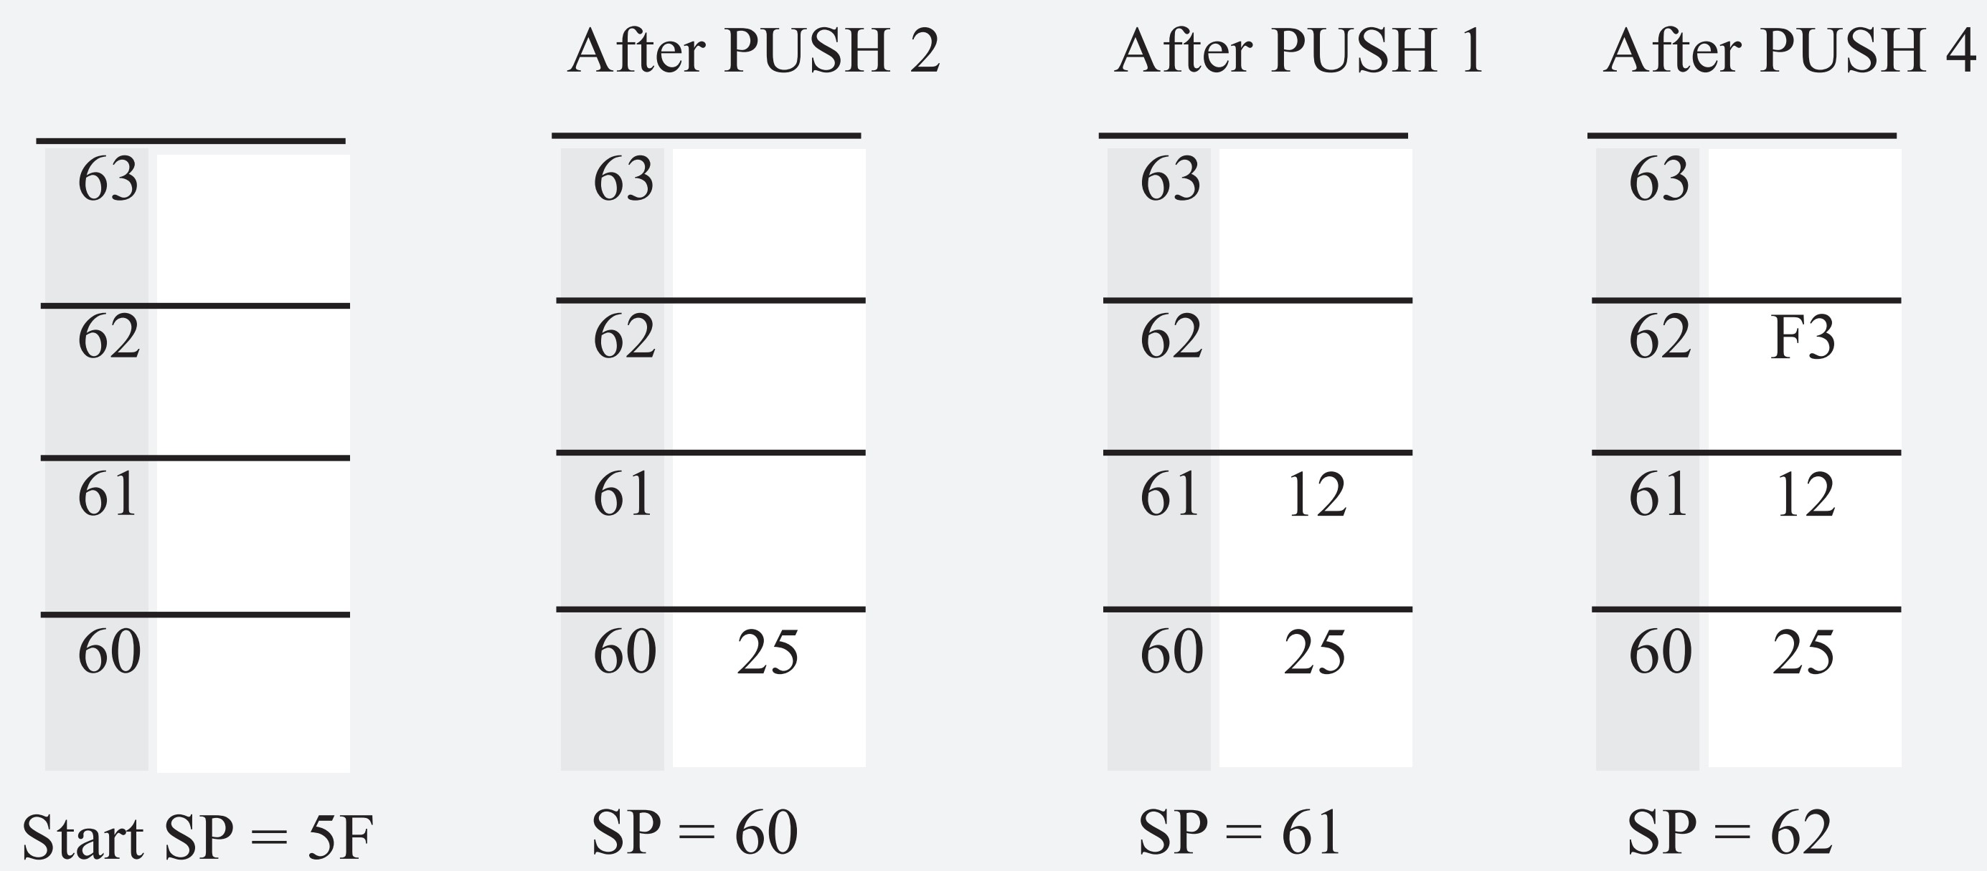
Example 2-10: Stack and Bank 1 Conflict
Show the stack and stack pointer for the following instructions.
MOV SP,#5FH ;make RAM location 60H
;first stack location
MOV R2,#25H
MOV R1,#12H
MOV R4,#0F3H
PUSH 2
PUSH 1
Solution:

Slide 28
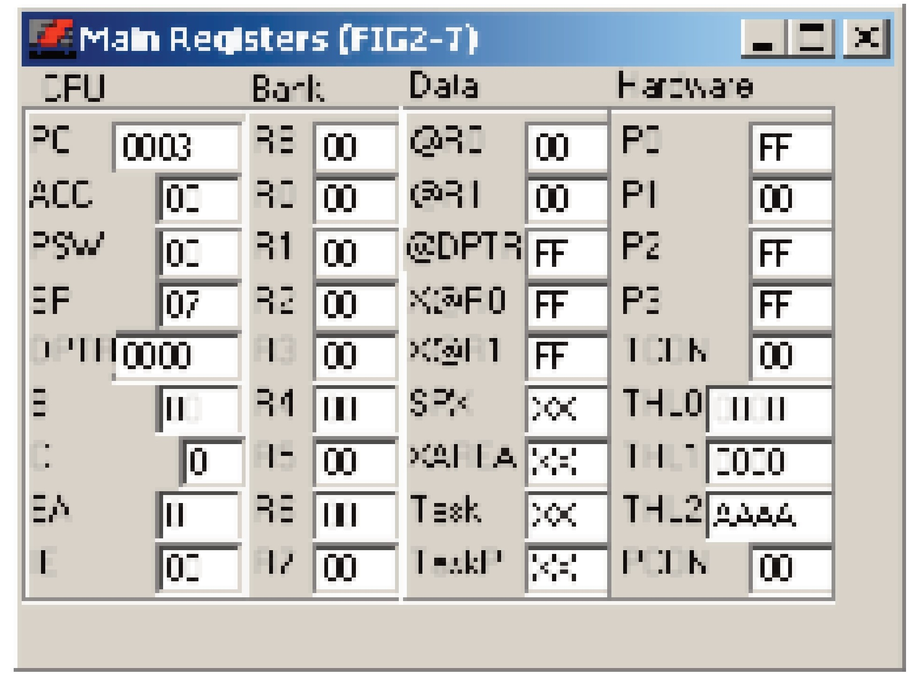
Viewing Registers and Memory with a Simulator
Figure 2-7. Register’s Screen from ProView 32 Simulator

Slide 29
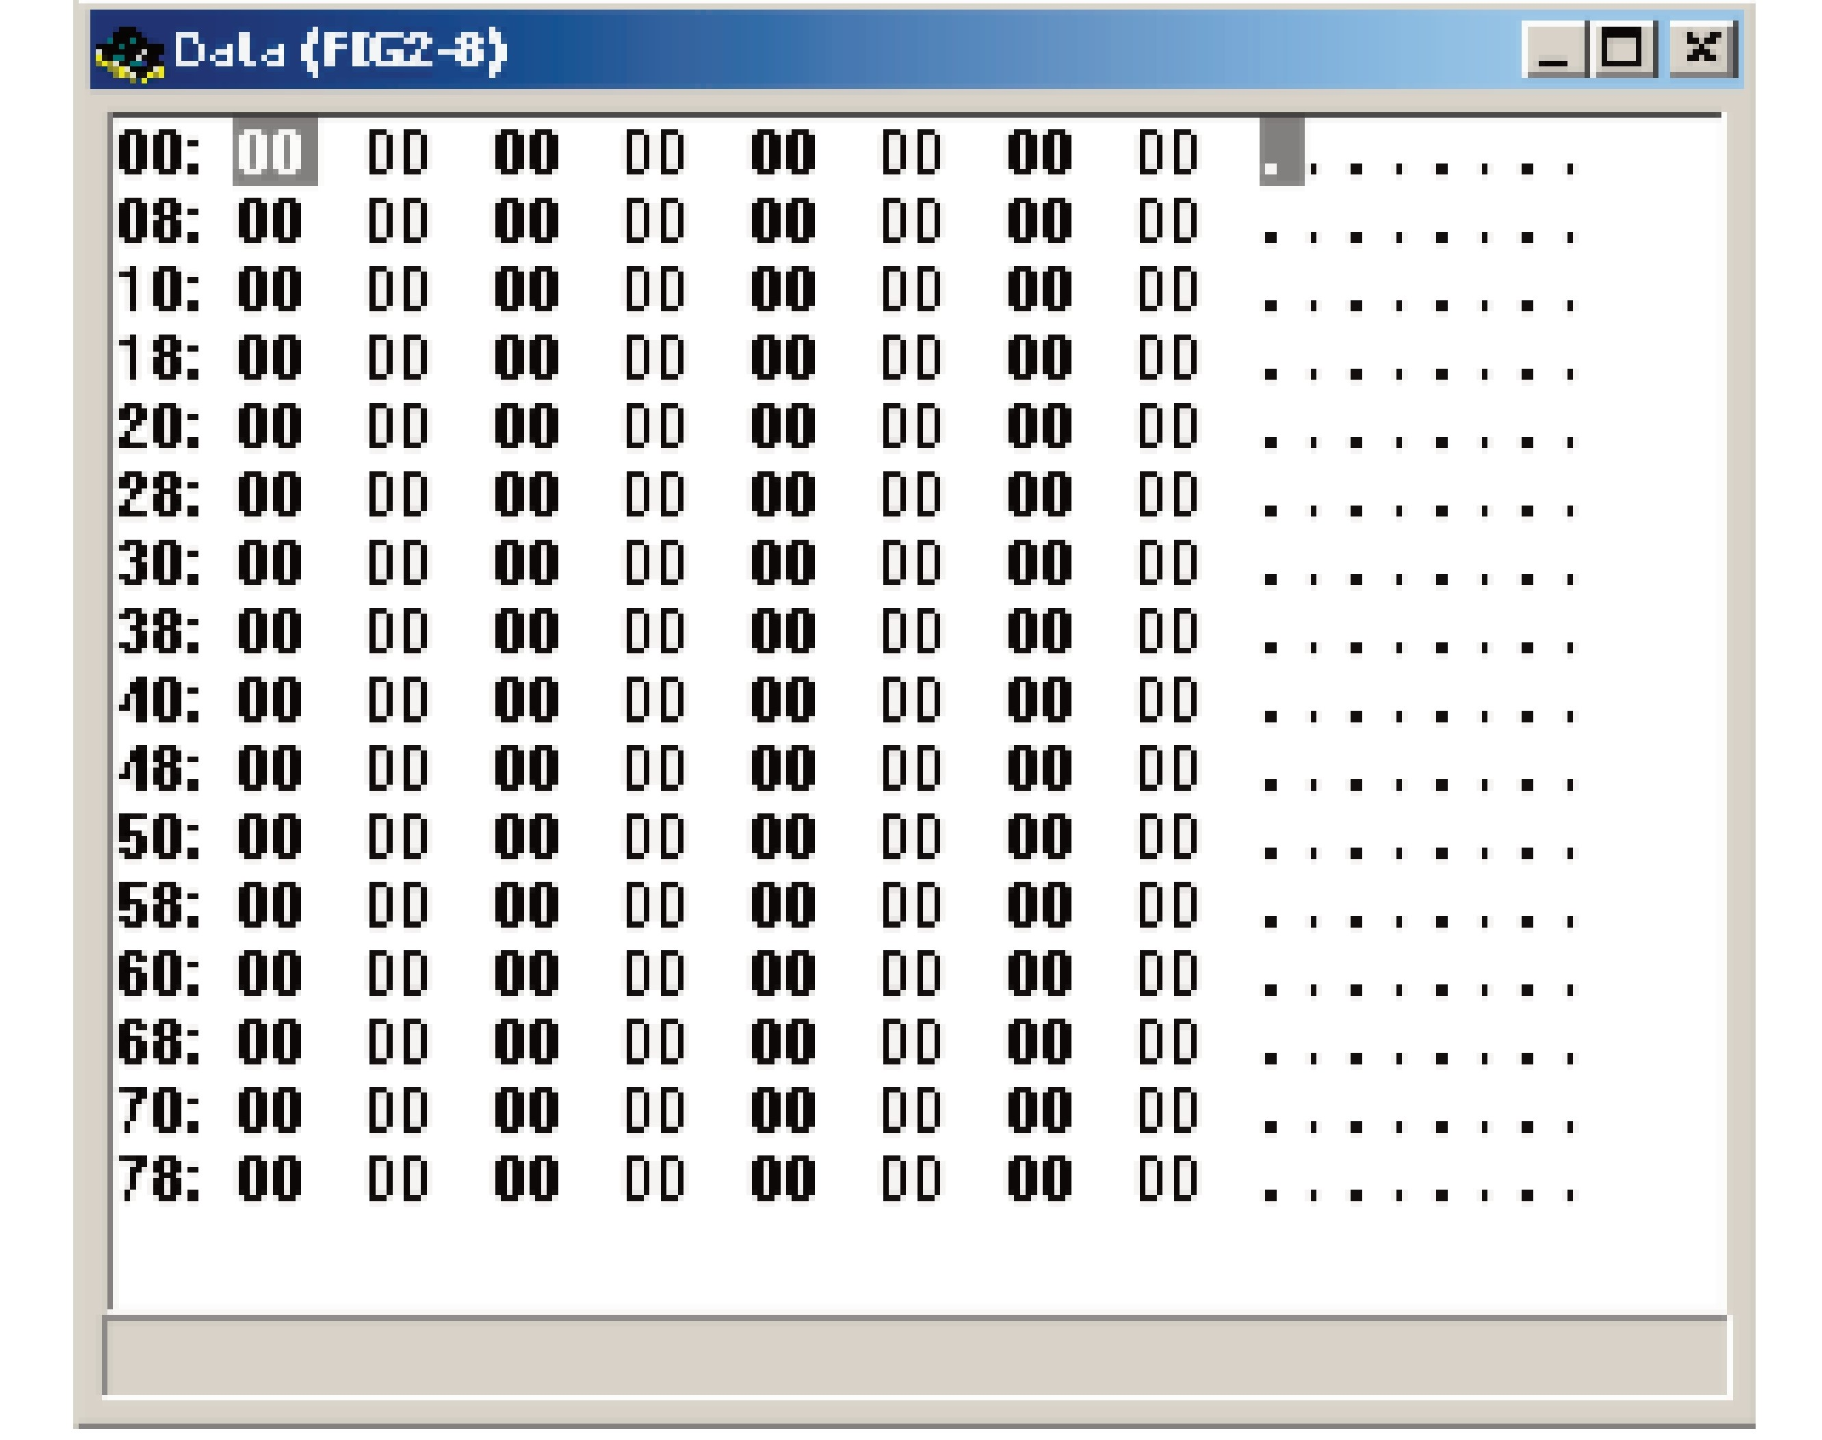
Viewing Registers and Memory with a Simulator
Figure 2-8. 128-Byte Memory Space from ProView 32 Simulator

Slide 30
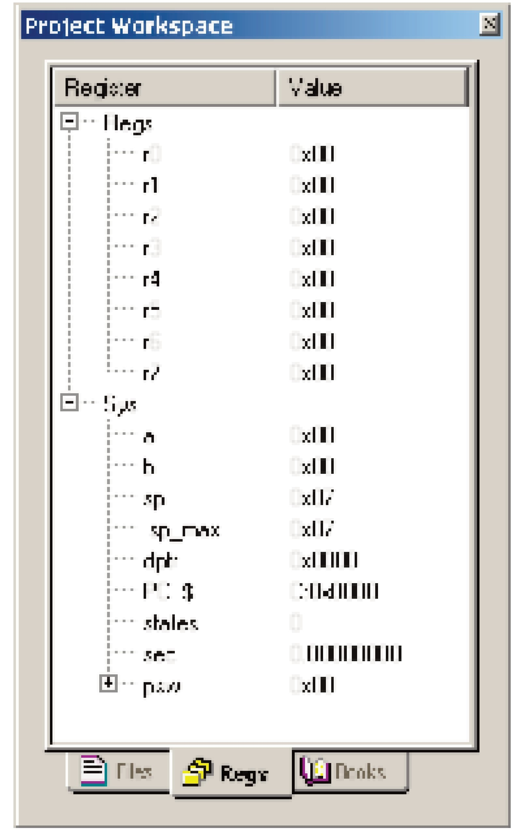
Viewing Registers and Memory with a Simulator
Figure 2-9. Register’s Screen from Keil Simulator

Slide 31
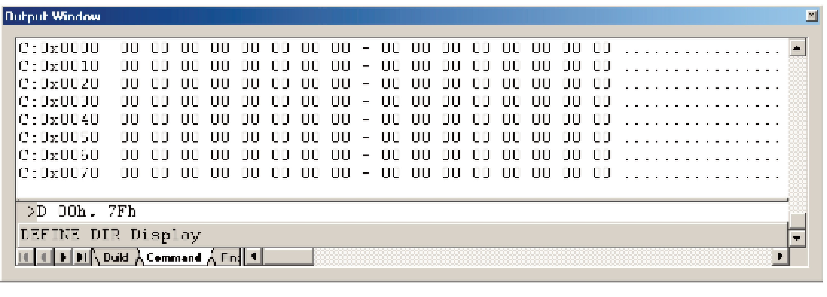
Viewing Registers and Memory with a Simulator
Figure 2-10. 128-Byte Memory Space from Keil Simulator

